Slide 1
An Operating System Kernel Frame Allocator in Rust
November 4, 2022

Slide 2
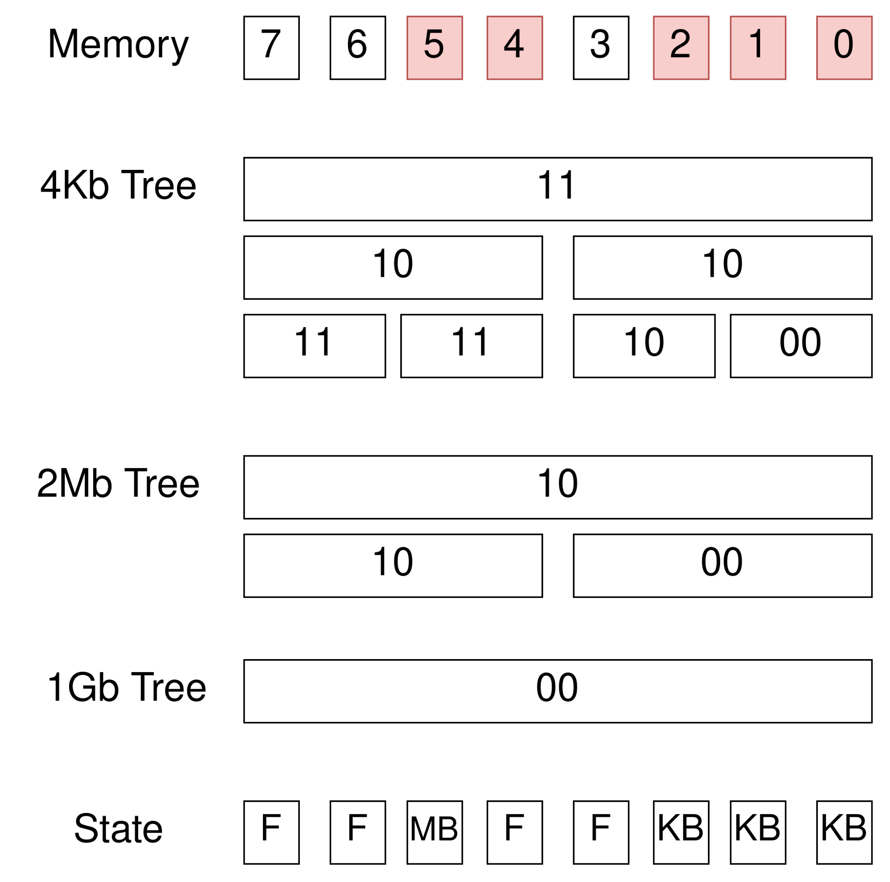
Buddy Allocator
Each block has 512 children
Max 512Gb with 3 levels
Blocks size: - 4Kb - 2Mb - 1Gb
Binary tree for simplification

Slide 3
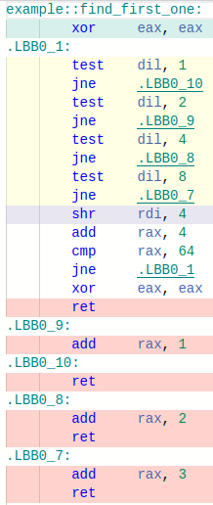
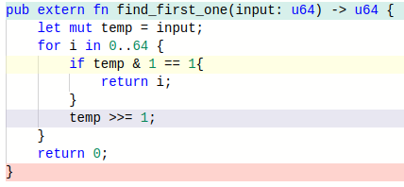
Bit Scan Forward (BSF) Operator
opt-level=3

Slide 4
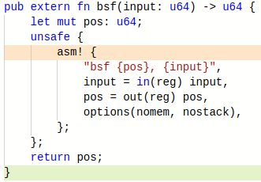

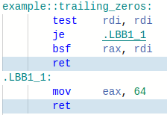

Bit Scan Forward (BSF) Operator Cont’d

Slide 5
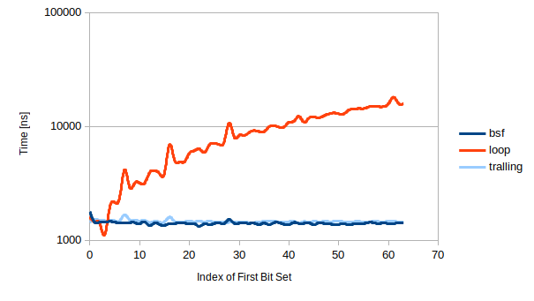

Bit Scan Forward (BSF) Operator Cont’d
1000 iterations per function
y-axis is logarithmic
BSF runs in constant time

Slide 6
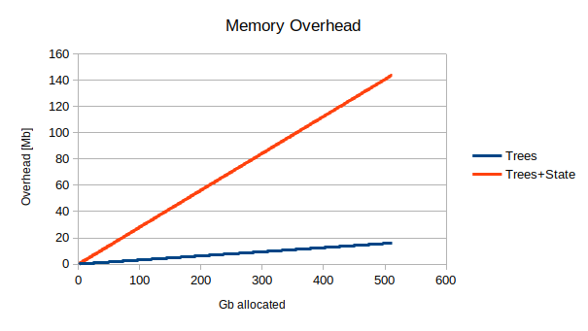
Memory Overhead
Additional data structures:
tree 4Kb
tree 2Mb
tree 1Gb
State array
biggest structure:
size ≃ 1/4*NB_GB Mb
Represents ~0.03% overhead

Slide 7
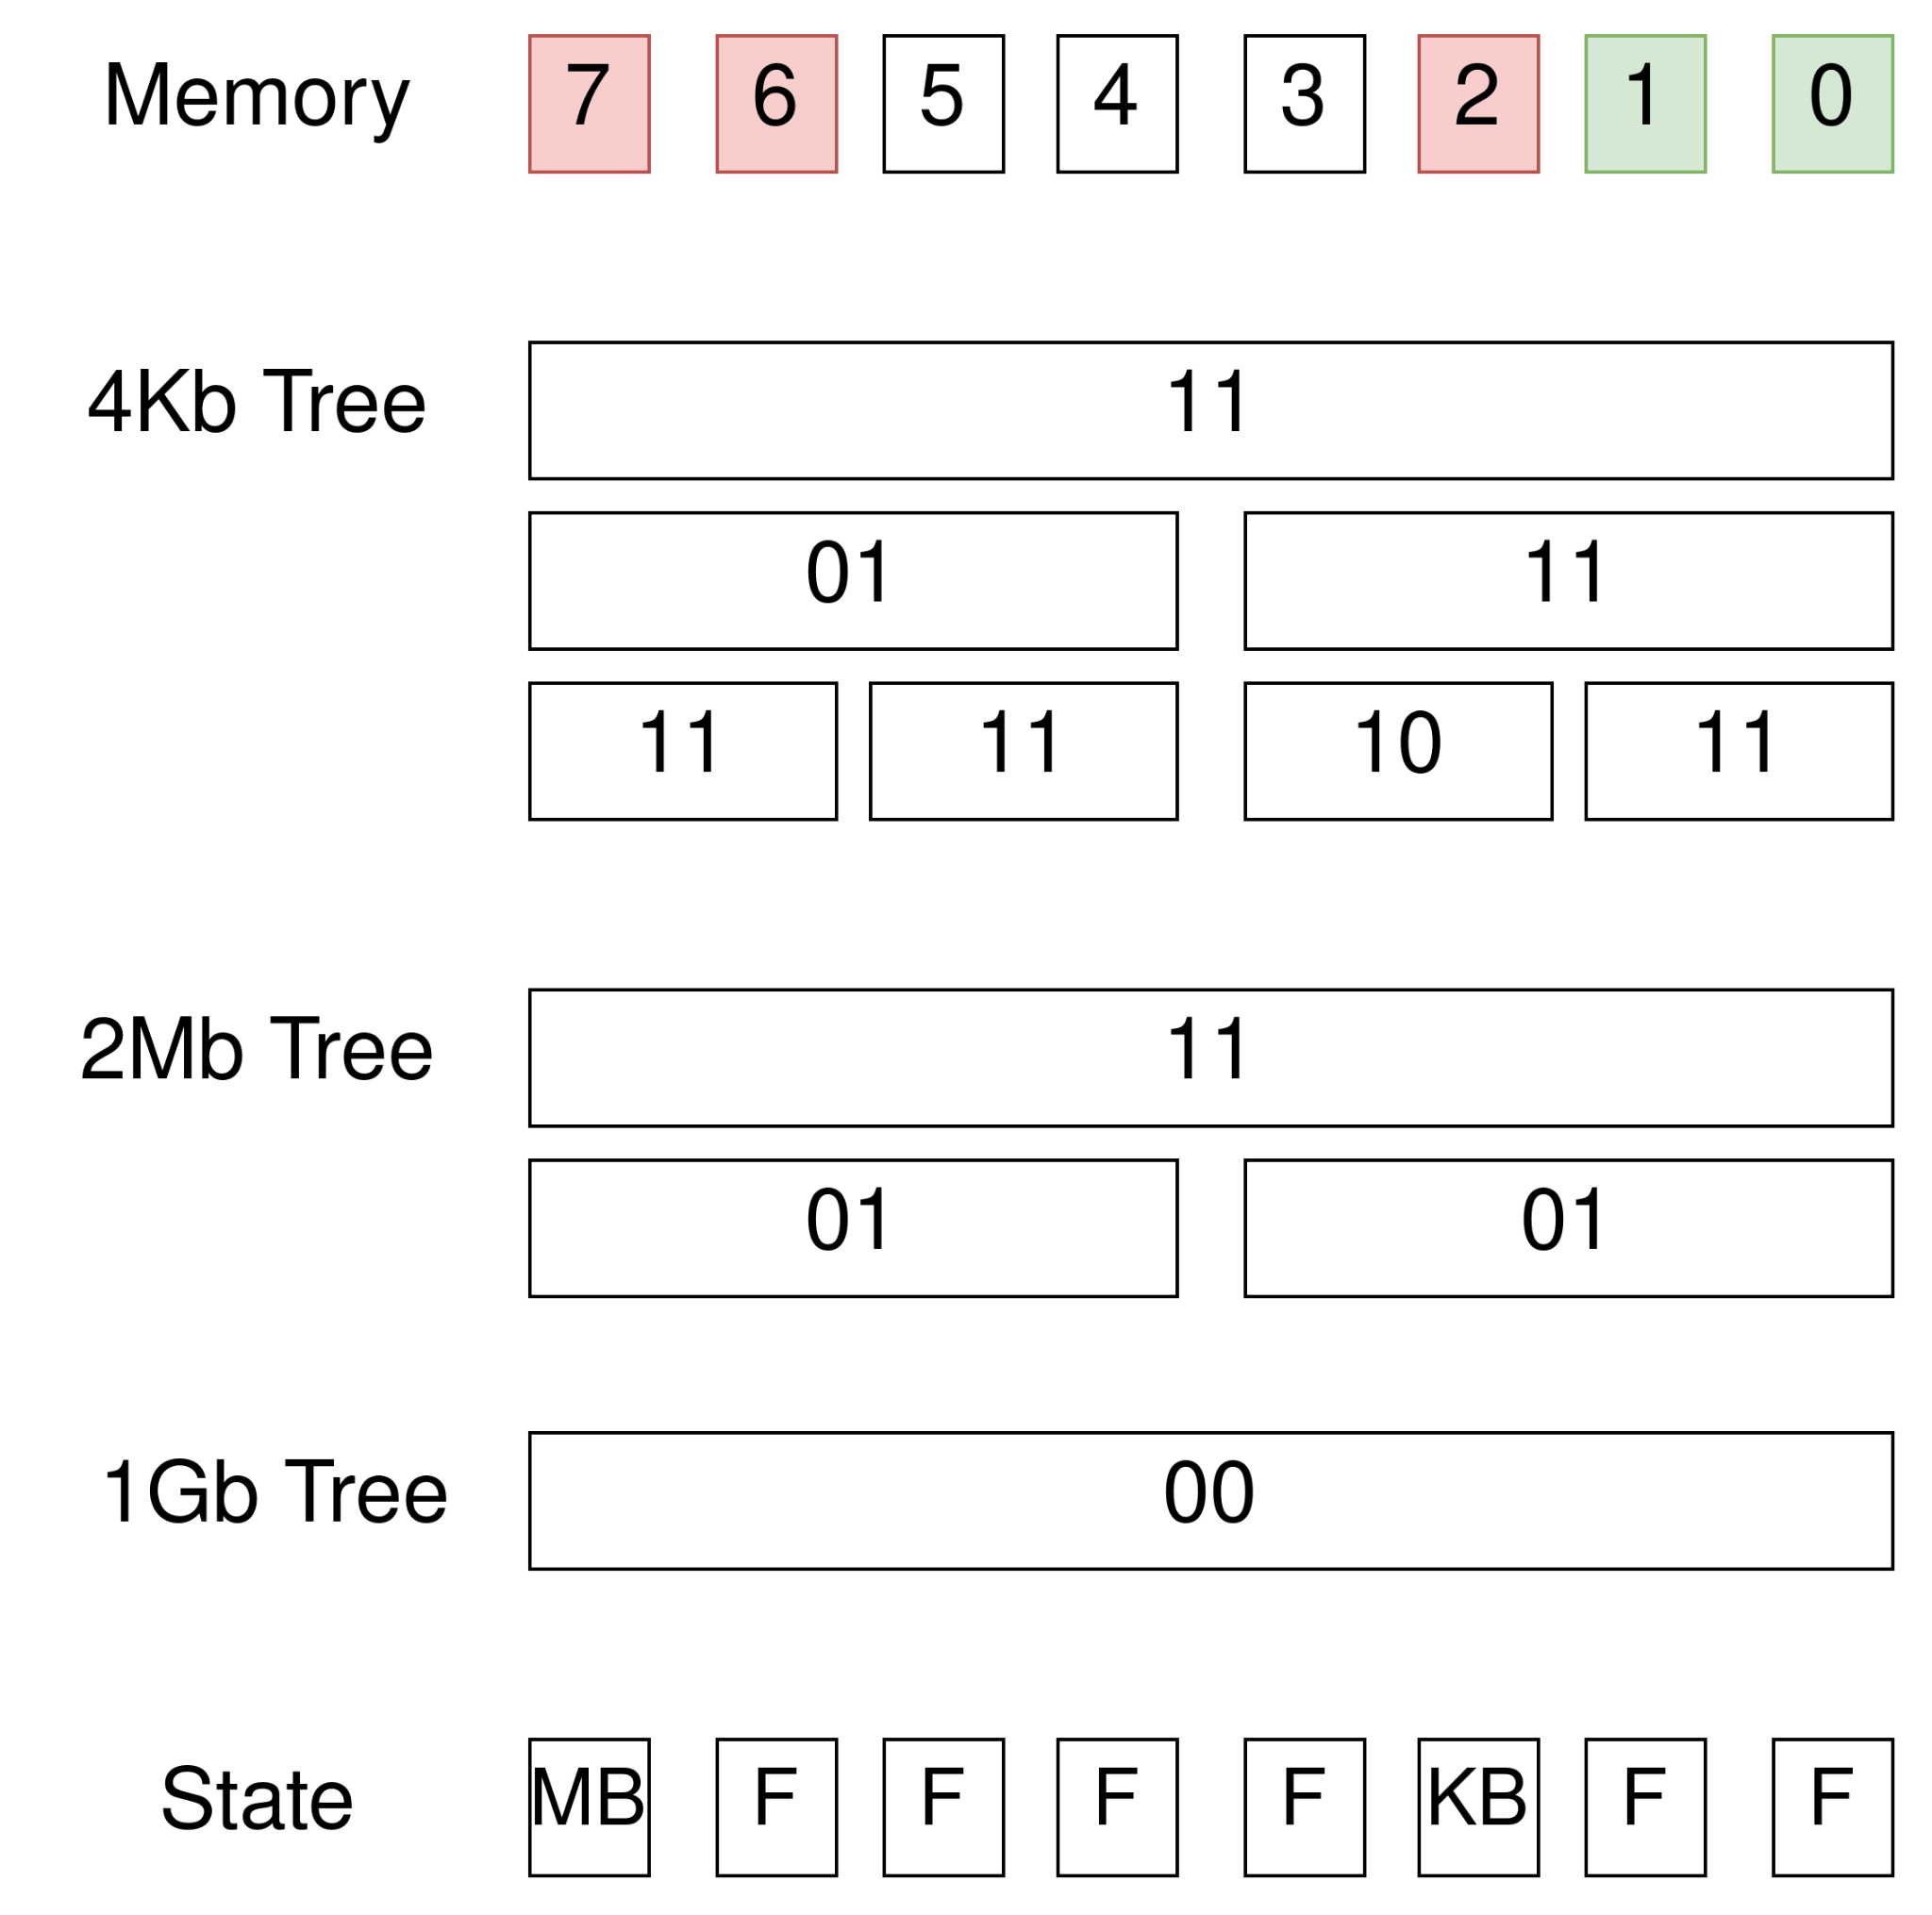
Memory Fragmentation
Idea to reduce fragmentation
Reverse the order of research for each tree
1Gb LSB first -> BSF
2Mb MSB first -> BSR (Bit Scan Reverse)
4Kb LSB first -> BSF

Slide 8
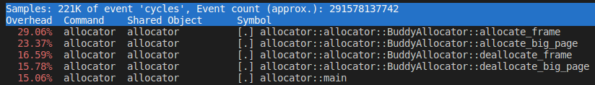
Performance
Percentage of time spent in each function

